Slide 1
Byteflix Presentation
Members:
Muhammad Choudhury
Maksym Mostovyy
Diana Hinostroza

Slide 2
Team Members
Members & Roles (primary / backup) - PM / Delivery Lead: Diana Hinostroza (Backup: Muhammad Choudhury) - ML Lead (modeling/eval): Maksym Mostovyy (Backup: Muhammad Choudhury) - Data/Streaming Lead (Kafka/ETL): Muhammad Choudhury (Backup: Diana Hinostroza) - DevOps/Cloud Lead (CI/CD, deploy, SRE): Muhammad Choudhury (Backup: Maksym Mostovyy)

Slide 3
Goal
The goal of Byteflix is to build and operate a production-grade, cloud-native movie recommendation system.
Probes/Traffic hits Cloud Run. -> API logs events to Confluent Kafka. -> Ingestor moves events to S3 (Data Lake). -> Retrainer consumes from S3.
Tools used:
Kafka: Real-time Streaming
Docker: Containerization
Google Cloud Run: Serverless Deployment

Slide 4

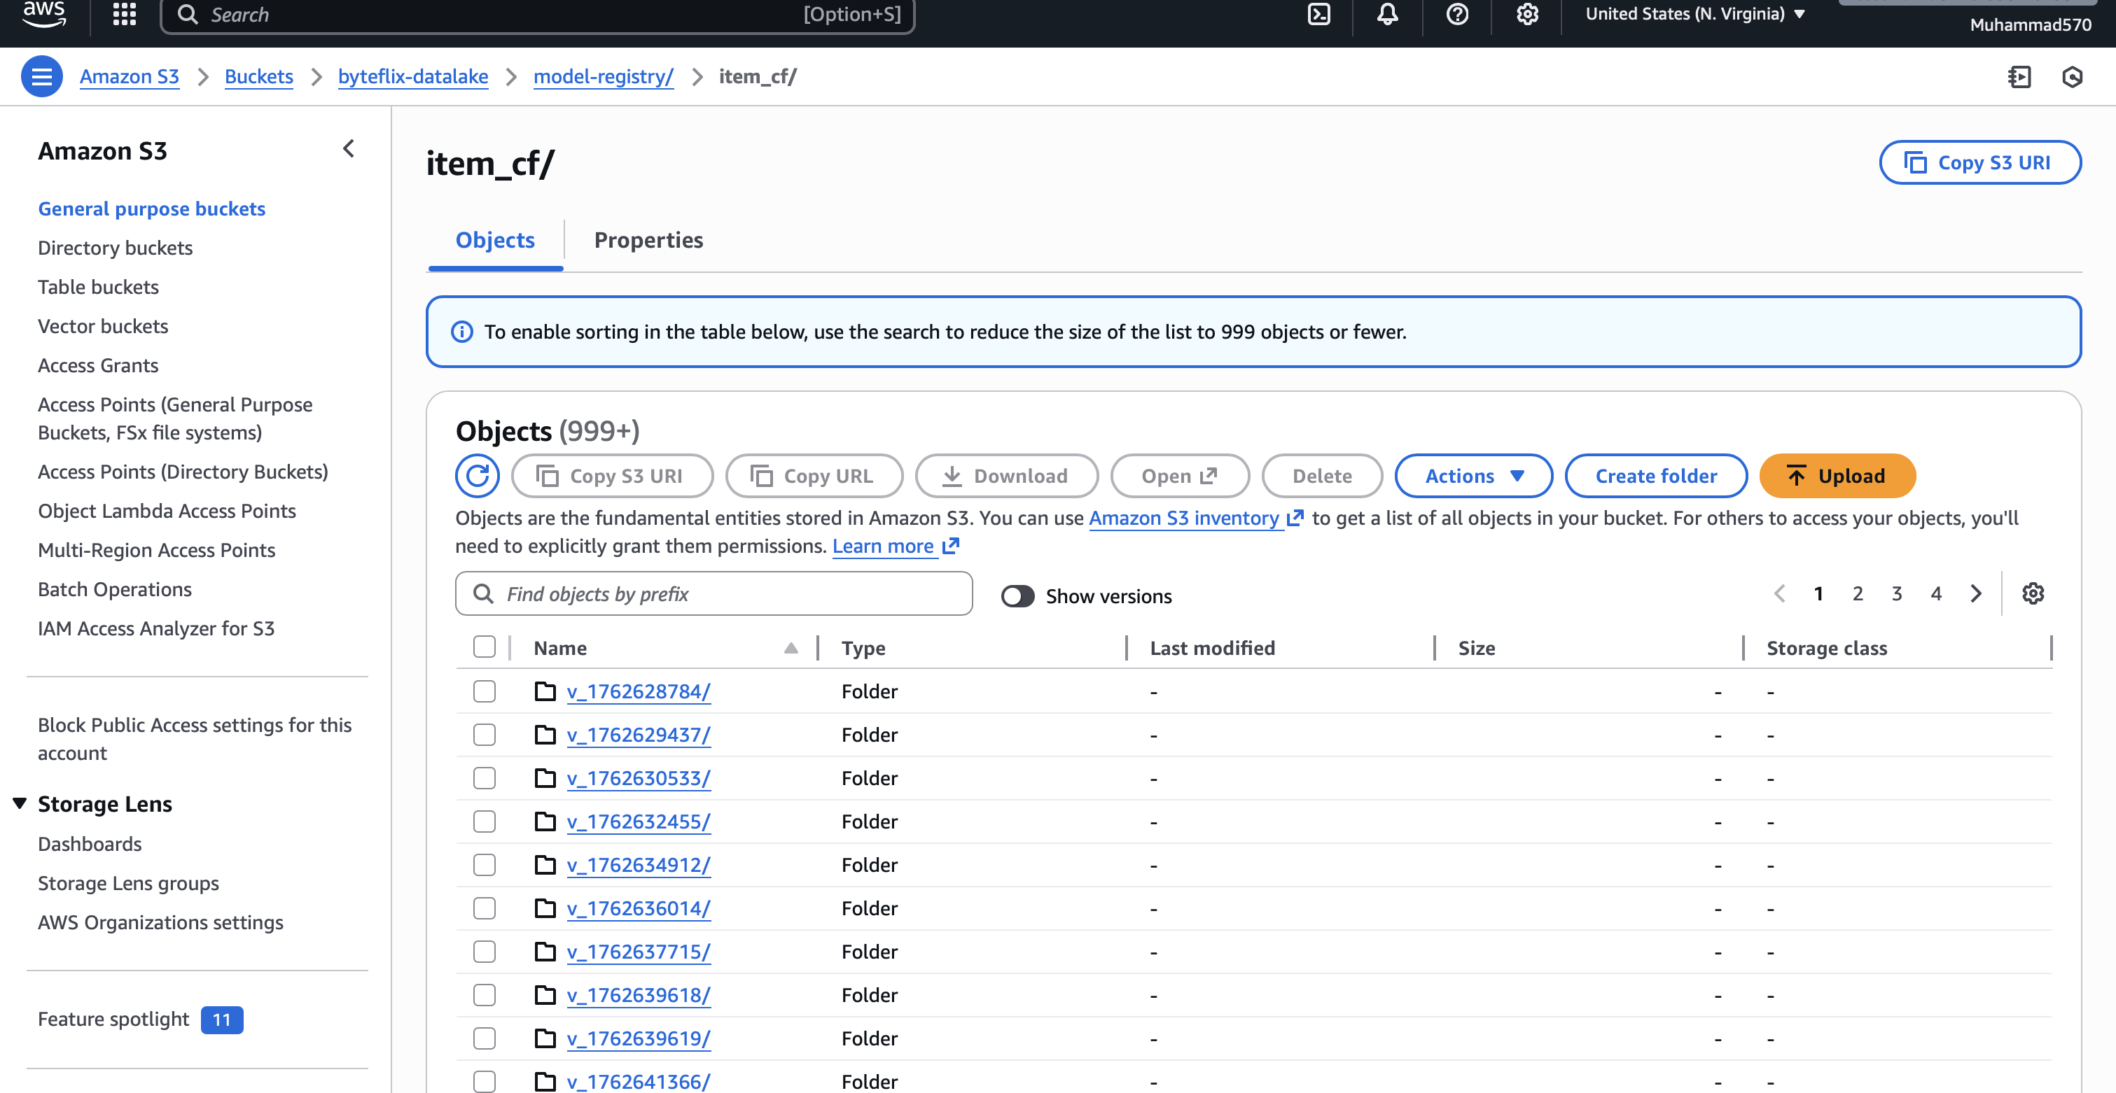
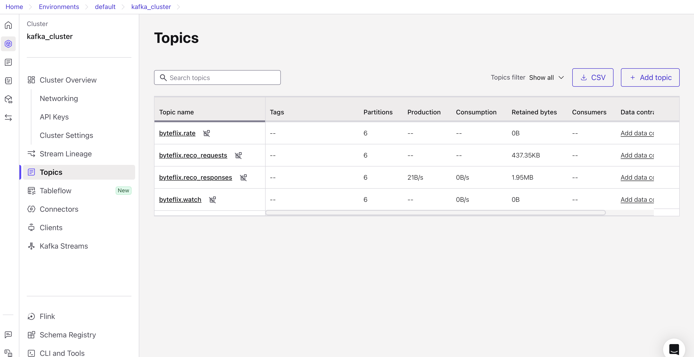
Storage and Topic Clusters
Our datalake storage for the models and data is all stored in AWS S3 Buckets
We use Confluent to manage and operate all the Kafka topics and clusters

Slide 5
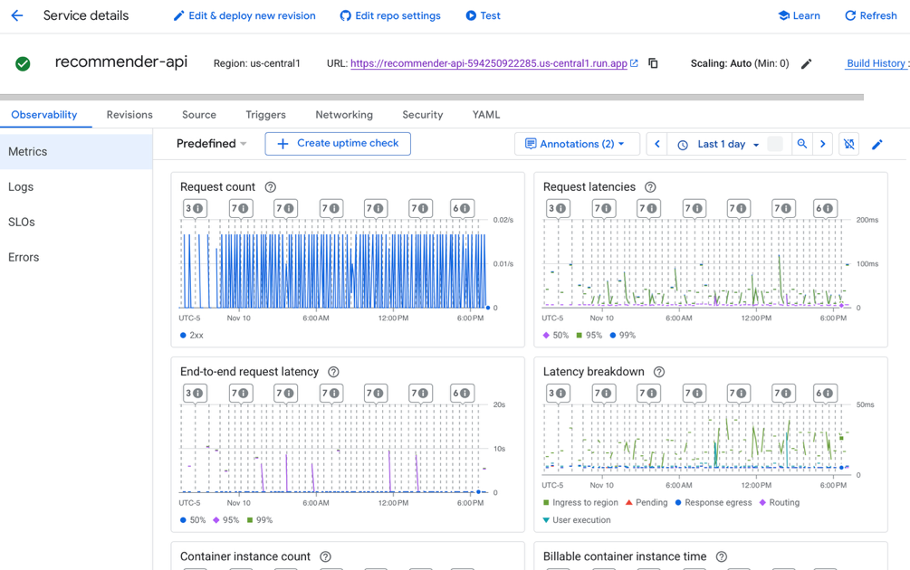
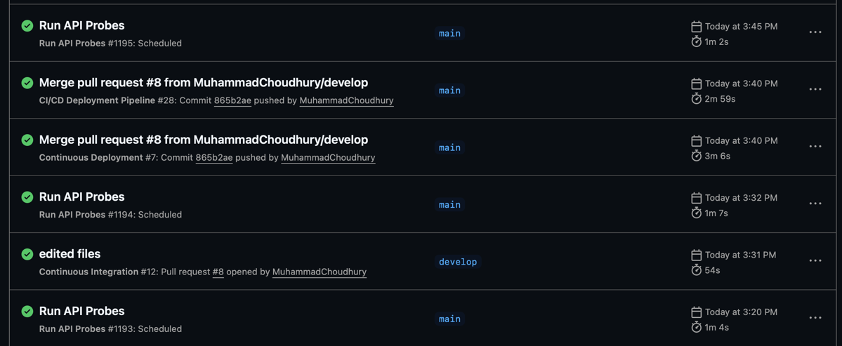
Monitoring, Cloud Hosting, and CI/CD
We used GitHub for the entire CI/CD lifecycle as well as the automated retraining and probes
We used Google Cloud Run for all the Cloud Hosting monitoring (Request Count, latencies, etc.) of the project

Slide 6

Video Demo
https://youtu.be/4qMd-QqddiU

